Slide 1

First Presentation of Project on
“SMART WHEELCHAIR AND HOME AUTOMATION FOR PARALYZED”
Presented by
24. JASIRA T P
34. NAYANA RAMESHAN
46. SHRAVAN SREEDEEP
48. SOORYA P
under the guidance of
Dr. C SREEKUMAR
DEPARTMENT OF ELECTRICAL & ELECTRONICS ENGINEERING
GOVT. COLLEGE OF ENGINEERING KANNUR- 670563
Oct 2021

Slide 2
Overview
Introduction
Objectives
Literature Review
Modified Scheme
Smart Wheelchair
Status of Project Work
Work Plan
Conclusion
Reference

Slide 3
INTRODUCTION
Paralyzed stroke patients are unable to normally communicate with their environment.
Part of their body that is under their control is their eyeballs.
Basic day to day operations are switching on basic devices like fan, bulb etc.
Smart Wheel Chair is the solution that we are proposing for these problems.

Slide 4
OBJECTIVES
To track eye movement and control basic devices like bulb, fan etc.
To design and implement an autonomous electric wheelchair.
To control the electric wheel chair by tracking eye movements.

Slide 5
LITERATURE REVIEW
[1]Joseph K George, Subhin K B, Arun Jose,Hima T, “Eye Controlled Home-Automation For Disables”, IOSR, 2019
Development of eye movement based detection device for home automation.
Eye blinks for controlling devices.
Eye tracking using camera requires a fully dedicated system with image processing software.
Controls fan, bulb, GSM module and alarm.

Slide 6
LITERATURE REVIEW
[2]Tan Kian Hou, Yagasena and Chelladurai, “Arduino based voice controlled wheelchair”, IEEE, 2019
Smart motorized voice controlled wheelchair.
Voice command controls the movements of the wheelchair.
Microcontroller used is Arduino Uno.

Slide 7
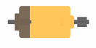
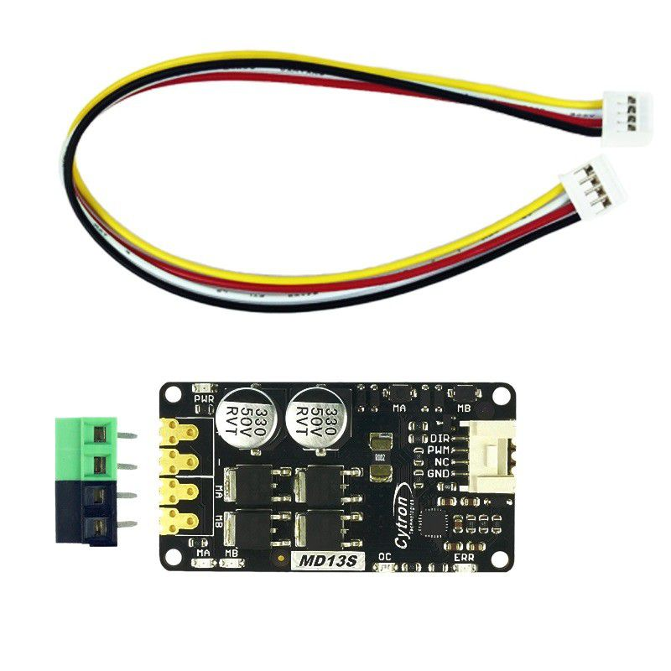
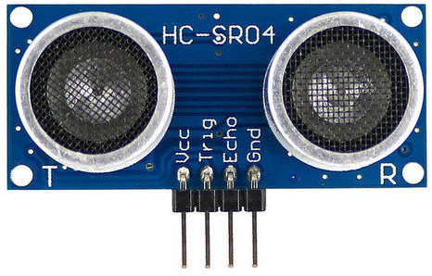
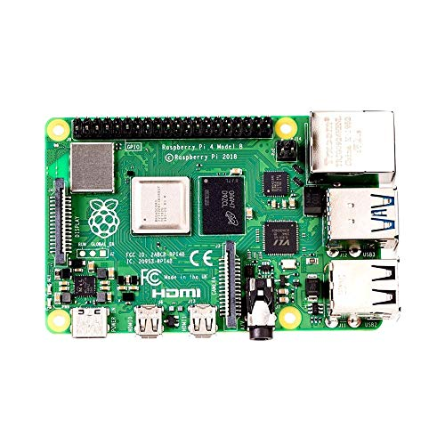
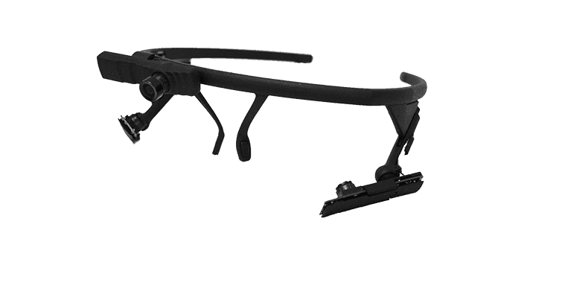
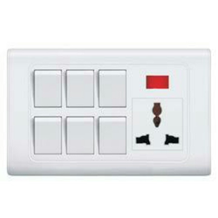
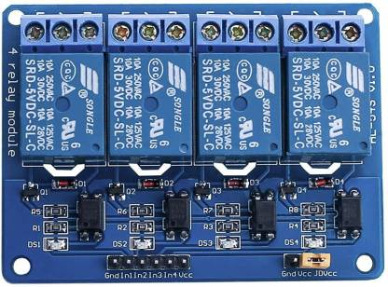
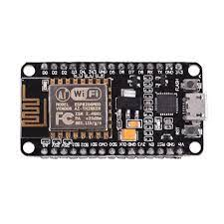
MODIFIED SCHEME
×8
LEFT MOTOR
DC MOTOR DRIVER
CAMERA MODULE
RIGHT MOTOR
RASPBERRY PI 4
RELAY CIRCUIT
NODE MCU
Fig 1. Block Diagram of Smart Wheelchair

Slide 8
SMART WHEELCHAIR
The whole project is divided into 3 parts
Eye tracking module using Raspberry Pi 4
Home automation system using Node MCU and Bluetooth Module
Wheel Chair

Slide 9
SMART WHEELCHAIR
Eye tracking module using Raspberry Pi 4
Camera Module is used to capture eye movements.
The eye movement is tracked using the python eye tracking model using Raspberry Pi 4.
The position of the pupil is transferred to Node MCU using Bluetooth module.

Slide 10
SMART WHEELCHAIR
Wheel Chair
Wheel chair is also controlled on the basics of the control signal received from Raspberry Pi 4.
The wheel chair have low speed for safety.
8 ultra sonic sensors are connected in 4 directions of the wheelchair for obstacle detection.
Incase an obstacle is identified the wheel chair stops and correct trajectory.

Slide 11
SMART WHEELCHAIR
Home automation system using Node MCU and Bluetooth Module
From the position received from Raspberry Pi 4, appropriate decision is taken by the Node MCU.
Control by Node MCU include the switches of light, fan and alarm.

Slide 12
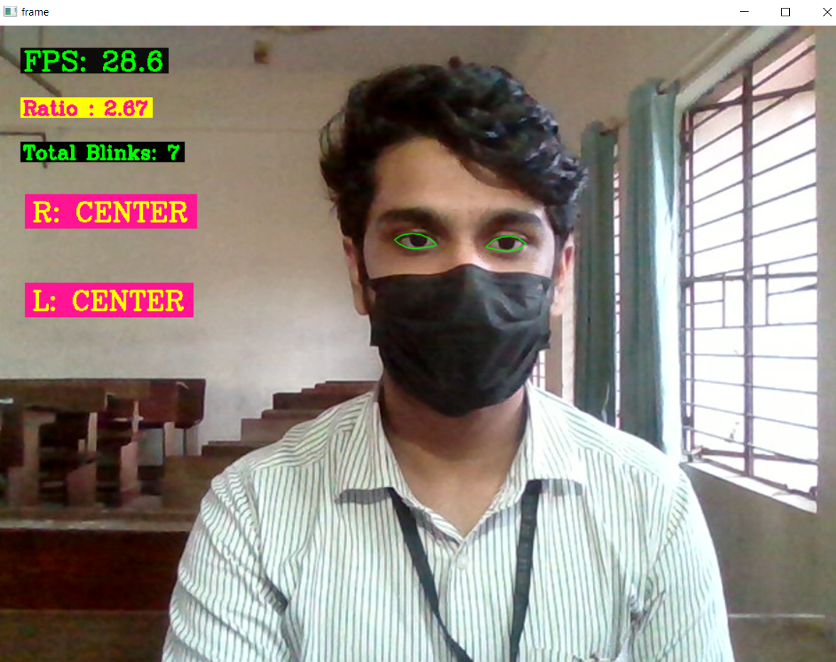
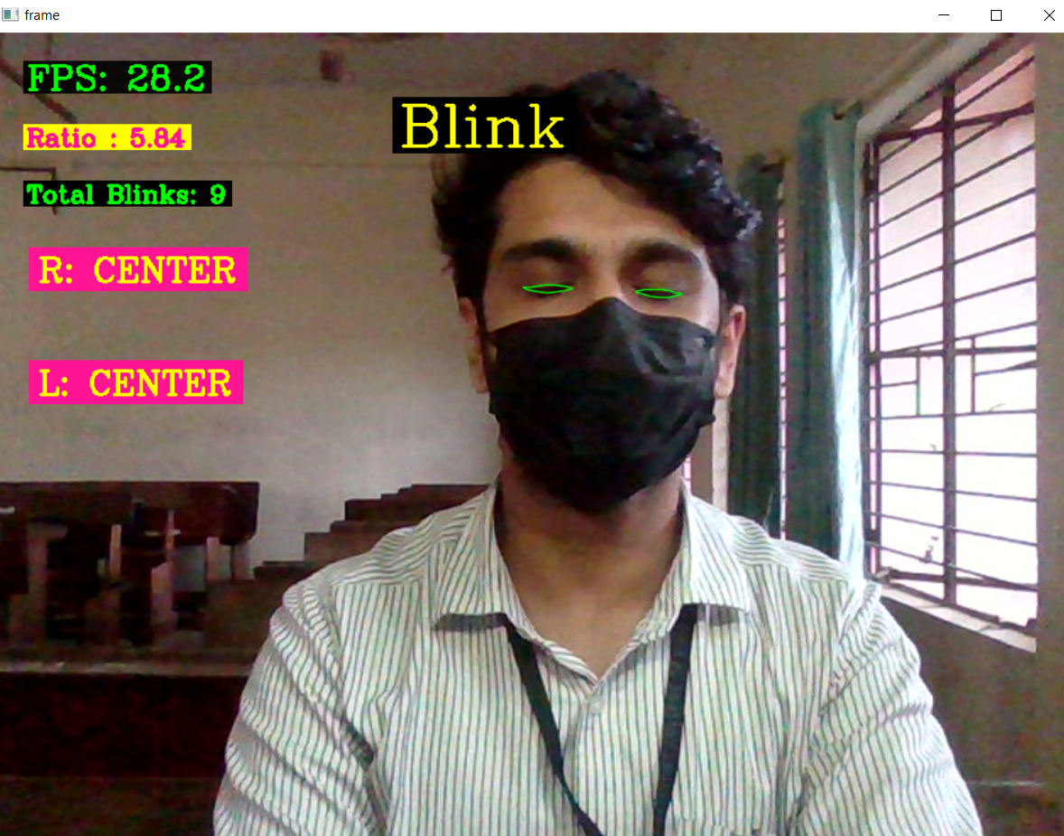
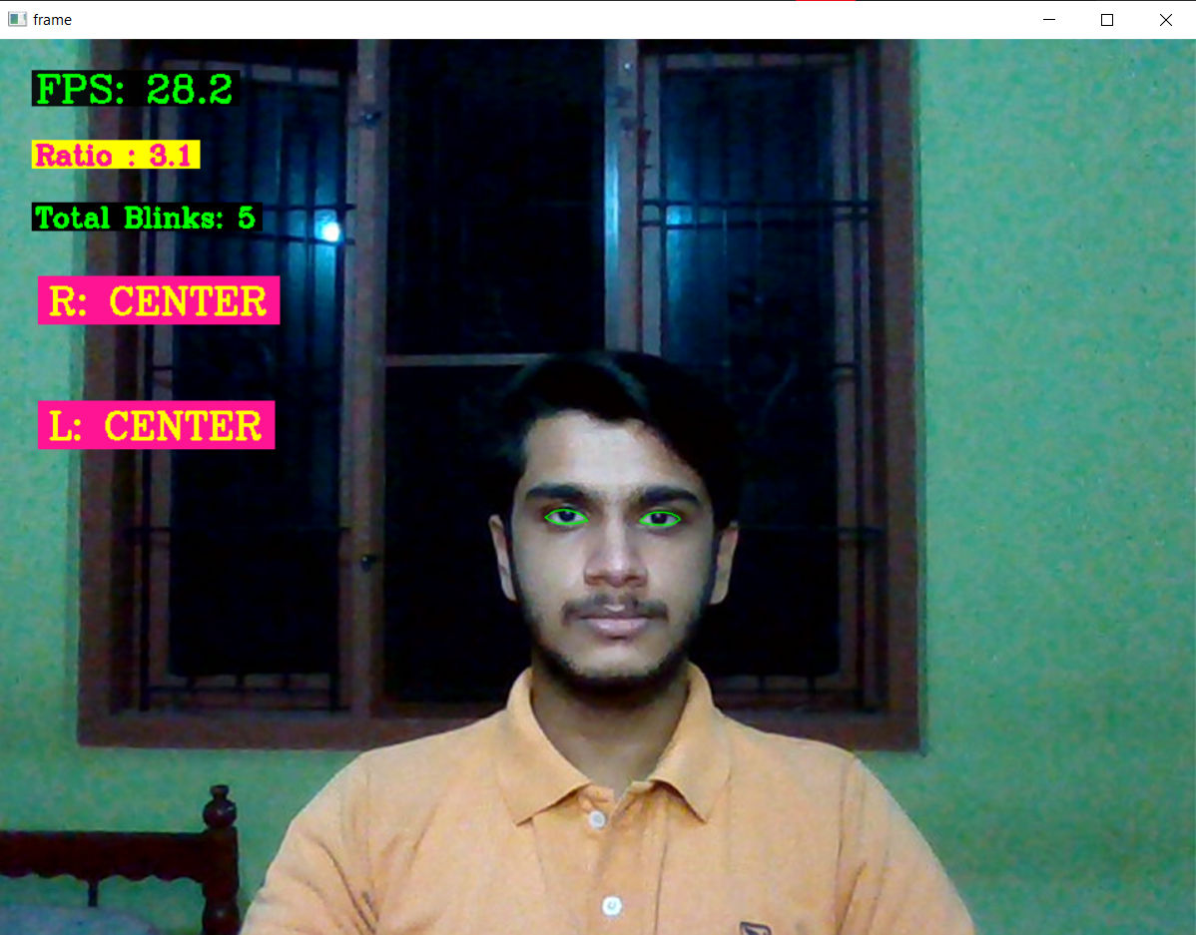
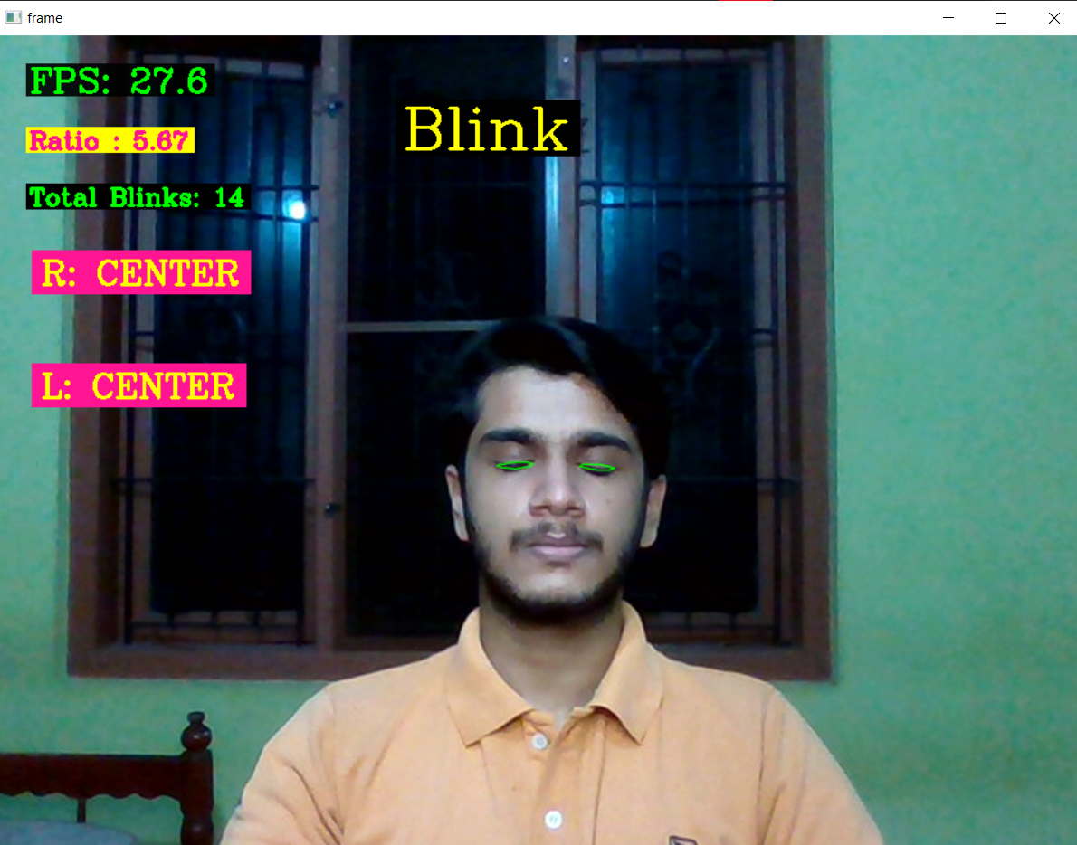
STATUS OF PROJECT WORK
Eye tracking program is developed and its results are shown below.
Fig 2.Straight
Fig 3. Closed

Slide 13
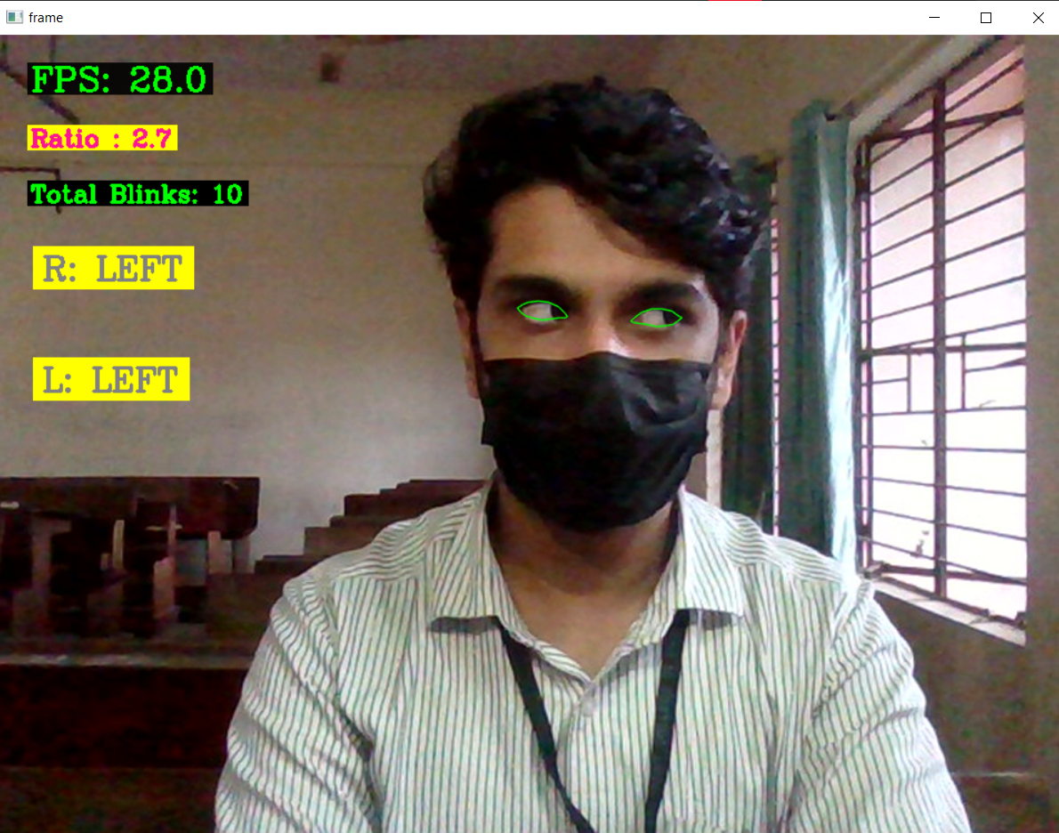
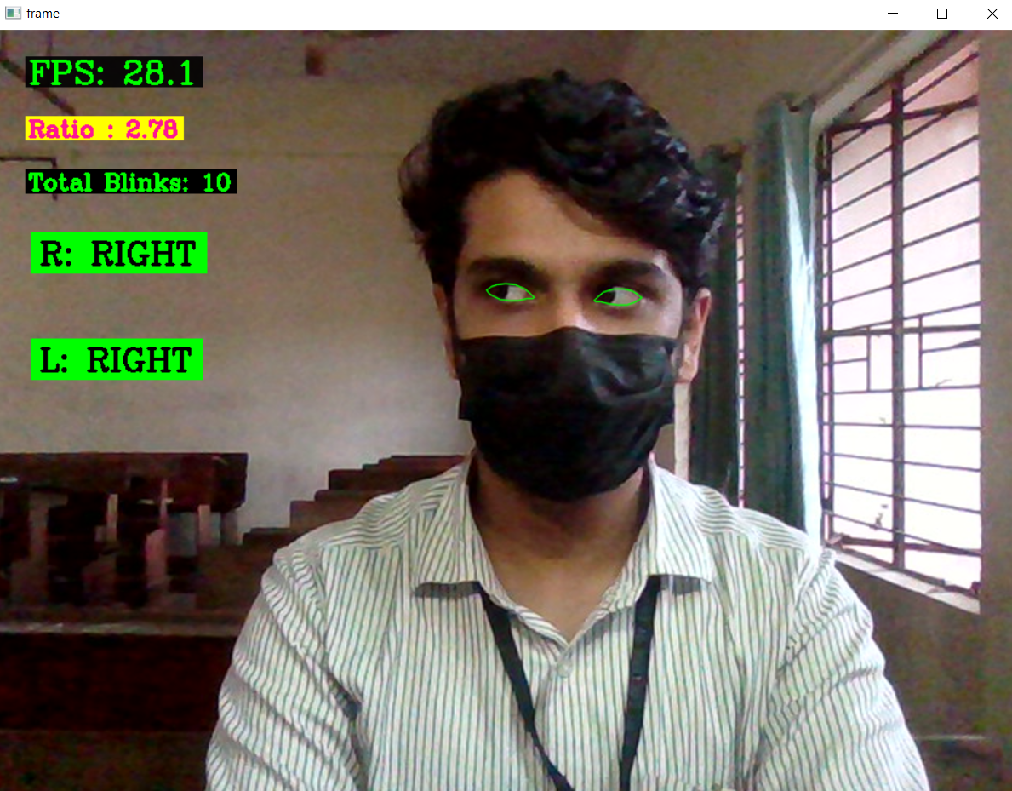
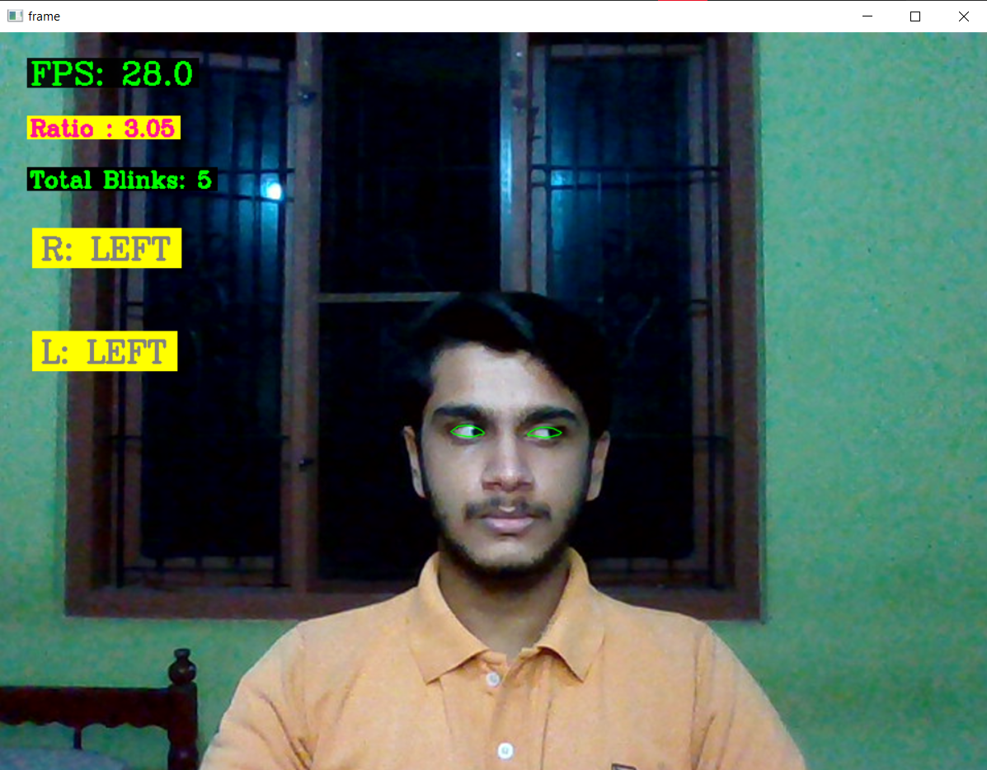
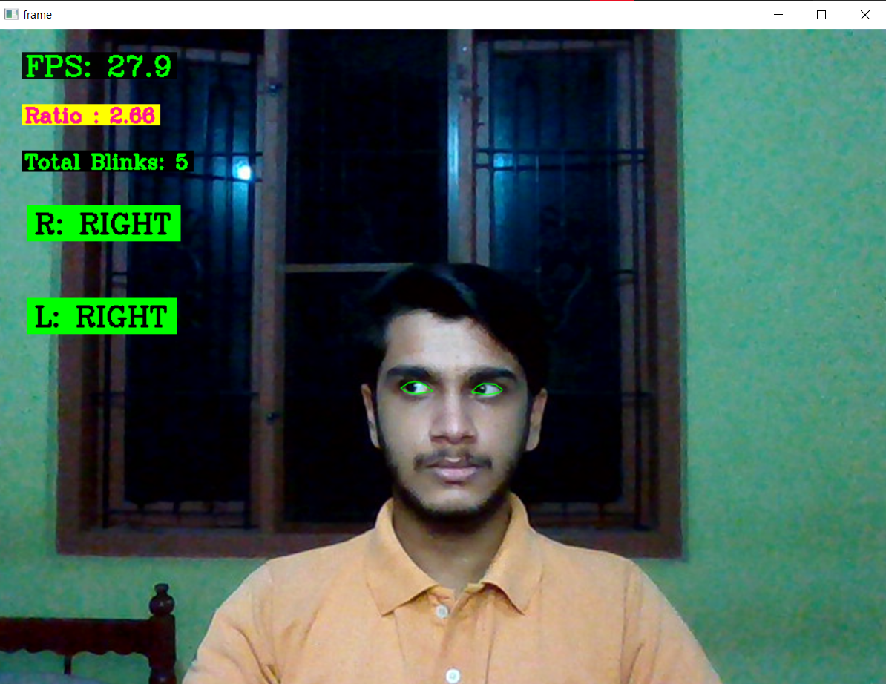
STATUS OF PROJECT WORK
Eye tracking program is developed and its results are shown below.
Fig 4. Left
Fig 5. Right

Slide 14
WORK PLAN
Work | Oct 2021 | Nov 2021 | 1-2 week Dec 2021 | 3-4 weeks Dec 2021 | 1-2 weeks Jan 2022 | 3-5 weeks Jan 2022 | Feb 2022 | Mar 2022 | May 2022
Topic selection and preliminary works
Literature Survey
Program and train machine learning model for eye tracking.
Design and implementation of mini prototype of autonomous wheelchair.
Design and implementation of the circuit for home automation.

Slide 15
WORK PLAN
Work | Oct 2021 | Nov 2021 | 1-2 week Dec 2021 | 3-4 weeks Dec 2021 | 1-2 weeks Jan 2022 | 3-5 weeks Jan 2022 | Feb 2022 | Mar 2022 | May 2022
Interface the eye tracker, home automation and wheelchair together.
Fabrication of home automation system.
Hardware implementation of eye tracking glasses.
Hardware implementation of autonomous wheel chair.
Test and solve real time issues.

Slide 16
CONCLUSION
Literature review for the proposed model are done.
After discussion and consultation, Raspberry Pi 4 is selected as the main controller.
Eye tracking model is developed.
Started working on small model of autonomous wheel chair.

Slide 17
REFERENCE
[1]Ahmad F. Klaib1, Nawaf O. Alsrehin1, Wasen Y. Melhem2, Haneen O. Bashtawi2, Aws A. Magableh1. “Eye Tracking Algorithms, Techniques, Tools, and Applications with an Emphasis on Machine Learning and Internet of Things Technologies”, September 2020
[2]Pramodini A. Punde, Dr. Mukti E. Jadhav, Dr. Ramesh R. Manza, “A study of Eye Tracking Technology and its applications”, 2017 IEEE
[3]Tan Kian Hou, Yagasena and Chelladurai“Arduino based voice controlled wheelchair”, 2020
[4]Joseph K George, Subhin K B, Arun Jose,Hima T, “Eye Controlled Home-Automation For Disables”, IOSR, 2019
[5] Deepak Kumar, Reetu Malhotra, S. R. Sharma, “Design and Construction of a Smart Wheelchair”, WEEF, 2019

Slide 18
THANK YOU

